Slide 1
Lecture 12
Matrices
Topics:
Matrices
Matrix Operations

Slide 2

Matrices
Definition: A matrix is a rectangular array of numbers. A matrix with m rows and n columns is called an m × n matrix. The plural of matrix is matrices. A matrix with the same number of rows as columns is called square. Two matrices are equal if they have the same number of rows and the same number of columns and the corresponding entries in every position are equal.
Example:

Slide 3
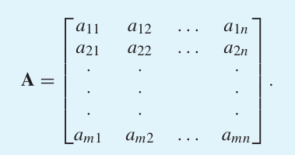
Matrices
Let m and n be positive integers and let
The ith row of A is the 1 × n matrix [a_{i1}, a_{i2}, … , a_{in}].

Slide 4
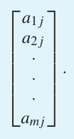
Matrices
The jth column of A is the m × 1 matrix
The (i, j)th element or entry of A is the element a_{ij}, that is, the number in the ith row and jth column of A. A convenient shorthand notation for expressing the matrix A is to write A = [a_{ij}], which indicates that A is the matrix with its (i, j)th element equal to a_{ij}.

Slide 5
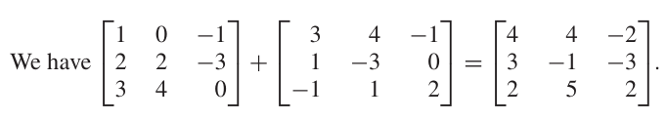
Matrix Arithmetic
Definition: Let A = [a_{ij}] and B = [b_{ij}] be m × n matrices. The sum of A and B, denoted by A + B, is the m × n matrix that has a_{ij} + b_{ij} as its (i, j)th element. In other words, A + B = [a_{ij} + b_{ij}].
The sum of two matrices of the same size is obtained by adding elements in the corresponding positions. Matrices of different sizes cannot be added, because such matrices will not both have entries in some of their positions.
Example:

Slide 6
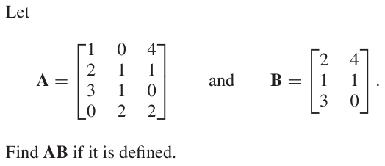
Matrix Product
Definition: Let A be an m × k matrix and B be a k × n matrix. The product of A and B, denoted by AB, is the m × n matrix with its (i, j)th entry equal to the sum of the products of the corresponding elements from the ith row of A and the jth column of B. In other words, if AB = [c_{ij}], then
c_{ij} = a_{i1}b_{1j} + a_{i2}b_{2j} + ⋯ + a_{ik}b_{kj}.
Example:

Slide 7
Matrix Product
The product of two matrices is not defined when the number of columns in the first matrix and the number of rows in the second matrix are not the same.

Slide 8
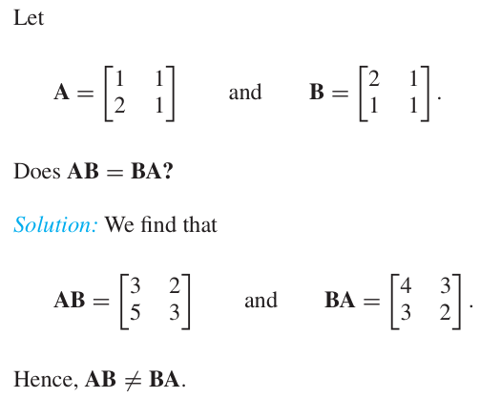
Matrix Product
Example:

Slide 9
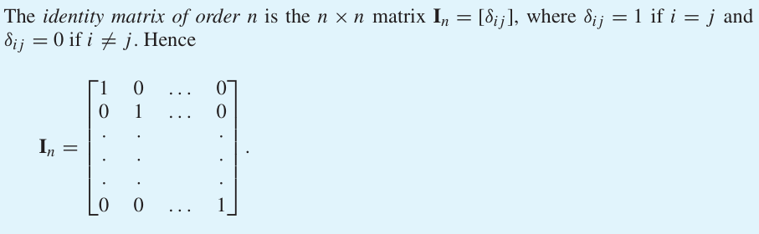
Identity Matrix

Slide 10


Multiplying a matrix by an appropriately sized identity matrix does not change this matrix. In other words, when A is an m × n matrix, we have
Powers of square matrices can be defined because matrix multiplication is associative. When A is an n × n matrix, we have

Slide 11
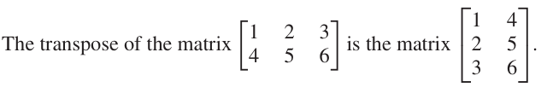
Transpose
Definition: Let A = [a_{ij}] be an m × n matrix. The transpose of A, denoted by A^{t} , is the n × m matrix obtained by interchanging the rows and columns of A. In other words, if A^{t} = [b_{ij}], then b_{ij} = a_{ji} for i = 1, 2, … , n and j = 1, 2, … , m.
Example:

Slide 12
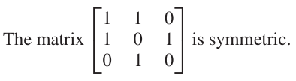
Symmetric Matrix
Definition: A square matrix A is called symmetric if A = A^{t} . Thus, A = [a_{ij}] is symmetric if a_{ij} = a_{ji} for all i and j with 1 ≤ i ≤ n and 1 ≤ j ≤ n.
Note that a matrix is symmetric if and only if it is square and it is symmetric with respect to its main diagonal (which consists of entries that are in the ith row and ith column for some i).
Example:

Slide 13
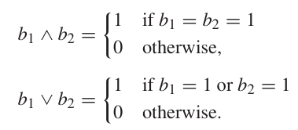
Zero–One Matrices
A matrix all of whose entries are either 0 or 1 is called a zero–one matrix. Zero–one matrices are often used to represent discrete structures. Algorithms using these structures are based on Boolean arithmetic with zero–one matrices. This arithmetic is based on the Boolean operations ∧ and ∨, which operate on pairs of bits, defined by

Slide 14
Join and Meet
Definition: Let A = [a_{ij}] and B = [b_{ij}] be m×n zero–one matrices. Then the join of A and B is the zero–one matrix with (i,j)th entry a_{ij} ∨ b_{ij}. The join of A and B is denoted by A ∨ B. The meet of A and B is the zero–one matrix with(i,j)th entry a_{ij} ∧ b_{ij}. The meet of A and B is denoted by A ∧ B.

Slide 15
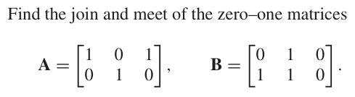
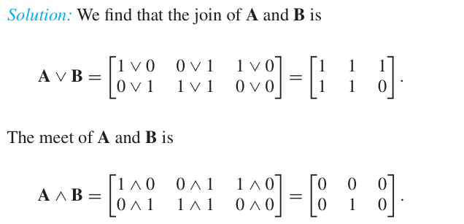
Join and Meet
Example:

